Slide 1
DISEASE PREDICTION

Slide 2
TEAM MEMBERS
187112 Krishna Sai
187127 Harshitha Karra
187134 Shamitha Mamidi
187139 Raghu Nagam
DATASET LINK: https://drive.google.com/drive/folders/1Db4WrDr3lyGNcaxw4iI6ptCs6sKaUzjL?usp=sha ringLink:
CODE LINK: https://github.com/raghu1547/Disease-Prediction

Slide 3
PROBLEM STATEMENT
Medical facilities need to be advanced so that better decisions for patient diagnosis and treatment options can be made. As we can observe that, Due to big data progress in biomedical and healthcare communities, early disease recognition, patient care, and community services are not efficiently provided.. Moreover, the quality of medical data is incomplete. Also, different regions exhibit unique appearances of certain regional diseases, which may result in weakening the prediction of disease outbreaks.

Slide 4

The main focus of our
project is to develop
a model for early
disease prediction and
smart healthcare.

Slide 5
FLOW CHART
Algorithms
Data pre-
processing
K-Fold
Learn Model
Performance
performance
Training dataset
Naive bayes
Random forest
Logistic regression
Decision tree
Disease dataset
Testing dataset
Model
Predict the disease based on symptoms

Slide 6
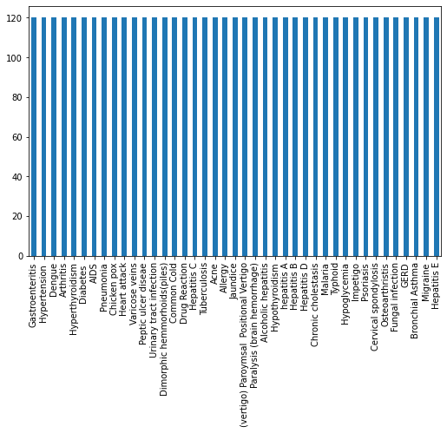
DISTRIBUTION OF FEATURES

Slide 7
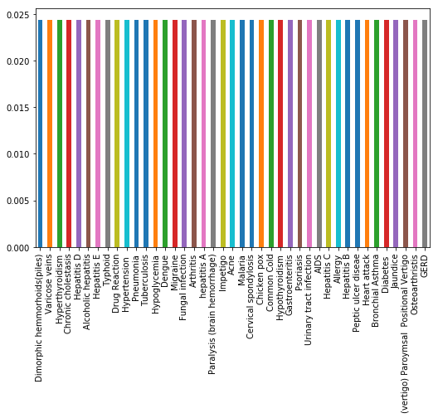
NORMALIZATION

Slide 8
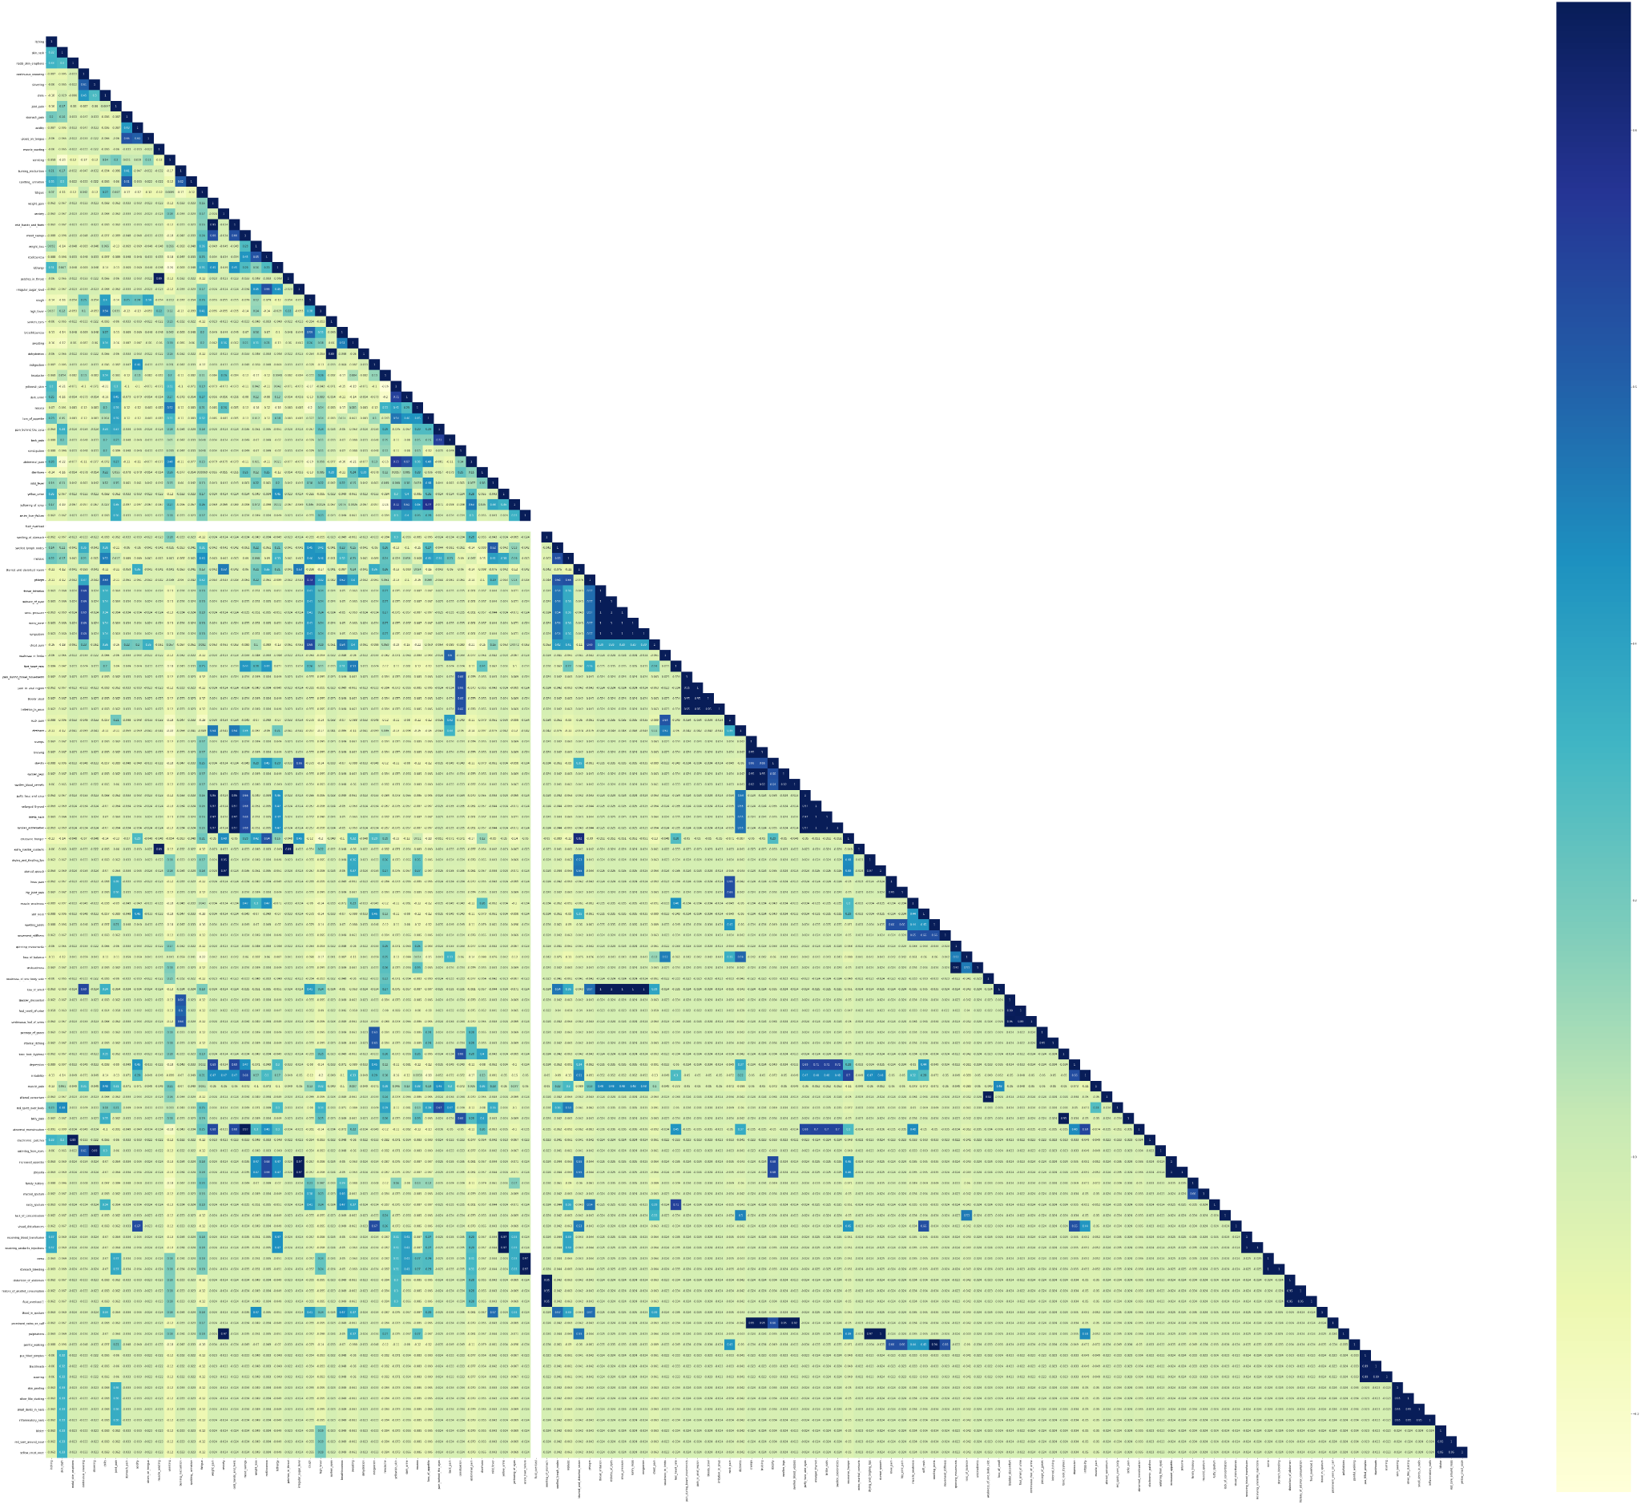
CORRELATION

Slide 9
Algorithms and Techniques Used
Naive-Bayes
Decision Tree
Cross Validation using K-Fold
Random Forest
Logistic Regression

Slide 10
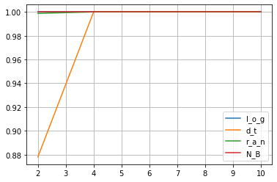
K-FOLD ACCURACY SCORES
Model (TRAIN) | k=2 | k=4 | k=6 | k=8 | k=10
‘log’ | 1.0 | 1.0 | 1.0 | 1.0 | 1.0
‘dt’ | 1.0 | 1.0 | 1.0 | 1.0 | 1.0
‘ran’ | 1.0 | 1.0 | 1.0 | 1.0 | 1.0
‘NB’ | 1.0 | 1.0 | 1.0 | 1.0 | 1.0
Model (TEST) | k=2 | k=4 | k=6 | k=8 | k=10
‘log’ | 1.0 | 1.0 | 1.0 | 1.0 | 1.0
‘dt’ | 1.0 | 0.869512 | 1.0 | 1.0 | 1.0
‘ran’ | 1.0 | 0.998780 | 1.0 | 1.0 | 1.0
‘NB’ | 1.0 | 1.0 | 1.0 | 1.0 | 1.0

Slide 11
Prediction of Disease (Using Logistic Regression)
7: chills
10: acidity
16: fatigue
27: high_fever
36: nausea
40: constipation
41: abdominal_pain
96: toxic_look_(typhos)
102: belly_pain
Enter your name :abc
Enter your age:20
Enter the Serial no.s in which your Symptoms exist: 7 10 16 27 36 40 41 96 102
Name of the infection = Typhoid , confidence score of : = 93.46987614886676 %
Name = abc , Age : = 20

Slide 12
CONCLUSION
This project-Disease prediction is to provide the users prediction for various and generally occurring diseases that when unchecked or sometimes ignored can turn into fatal disease.
It also plays a major role if adopted by a healthcare sector in order to reduce the amount of work of doctors and can easily predict the disease of patients.

